Slide 1


INSTRUCTIONS
TEAM OFFICIALS REGISTRATION
TEAM OFFICIAL SIGNING LINEUPS
SCOREKEEPING
REFEREES

Slide 2
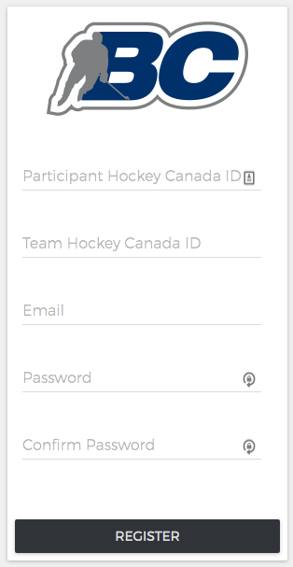
https://admin.hisports.app/register
TEAM OFFICIALS REGISTRATION
First step : type the URL on your device or computer browsers (iOS and Android are supported)
Fill the form
  Make sure you have your Participant HCR ID
  Same with your team HCR ID
  Key in the email you want to receive scoresheet. your email will become your user name
  Create your password
This step as to be done just once.

Slide 3
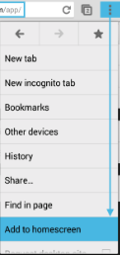
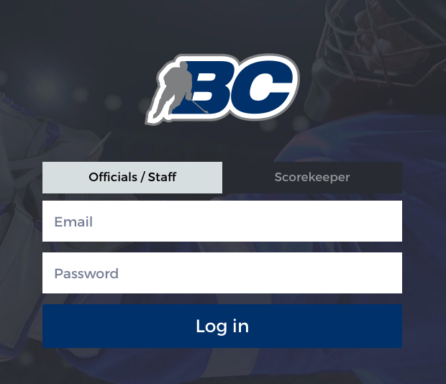
TEAM OFFICIALS SIGNING LINEUPS
https://hisports.app/login
Use the Officials / Staff tab
  Type in your email. Use the email you input at registration
  Same with your team HCR ID
  Key in the email you want to receive scoresheet. your email will become your user name
  Create your password
This step can be done on your phone, tablet or computer browsers (iOS and Android are supported)
If you use your phone or tablet, we suggest that at the prompt screen, you tap the top right menu and select ADD TO HOMESCREEN. This will add a shortcut to your home screen.

Slide 4
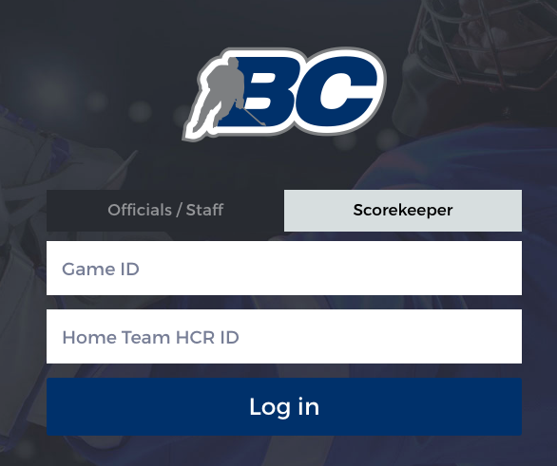
SCOREKEEPING
https://hisports.app/login
Use the SCOREKEEPER tab
  Type game ID. Game ID can be found on website under schedule. See next slide
  Home Team HCR ID, Team Officials should know that ID
Scorekeeping can be done on your phone, tablet or computer browsers (iOS and Android are supported)
If you use your phone or tablet, we suggest that at the prompt screen, you tap the top right menu and select ADD TO HOMESCREEN. This will add a shortcut to your home screen.
PreGAME process : Until scorekeeper get to START GAME, the device HAS to be connected to a network, whatever it is on cell or WIFI

Slide 5
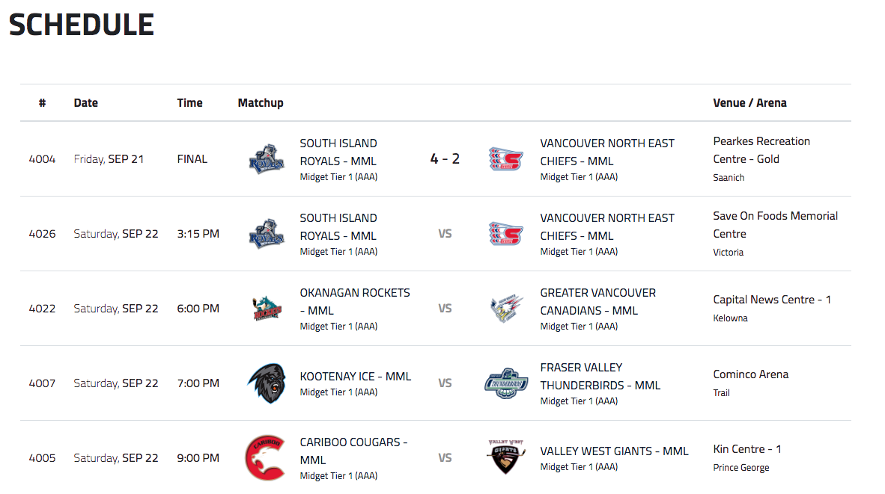
Game #

Slide 6
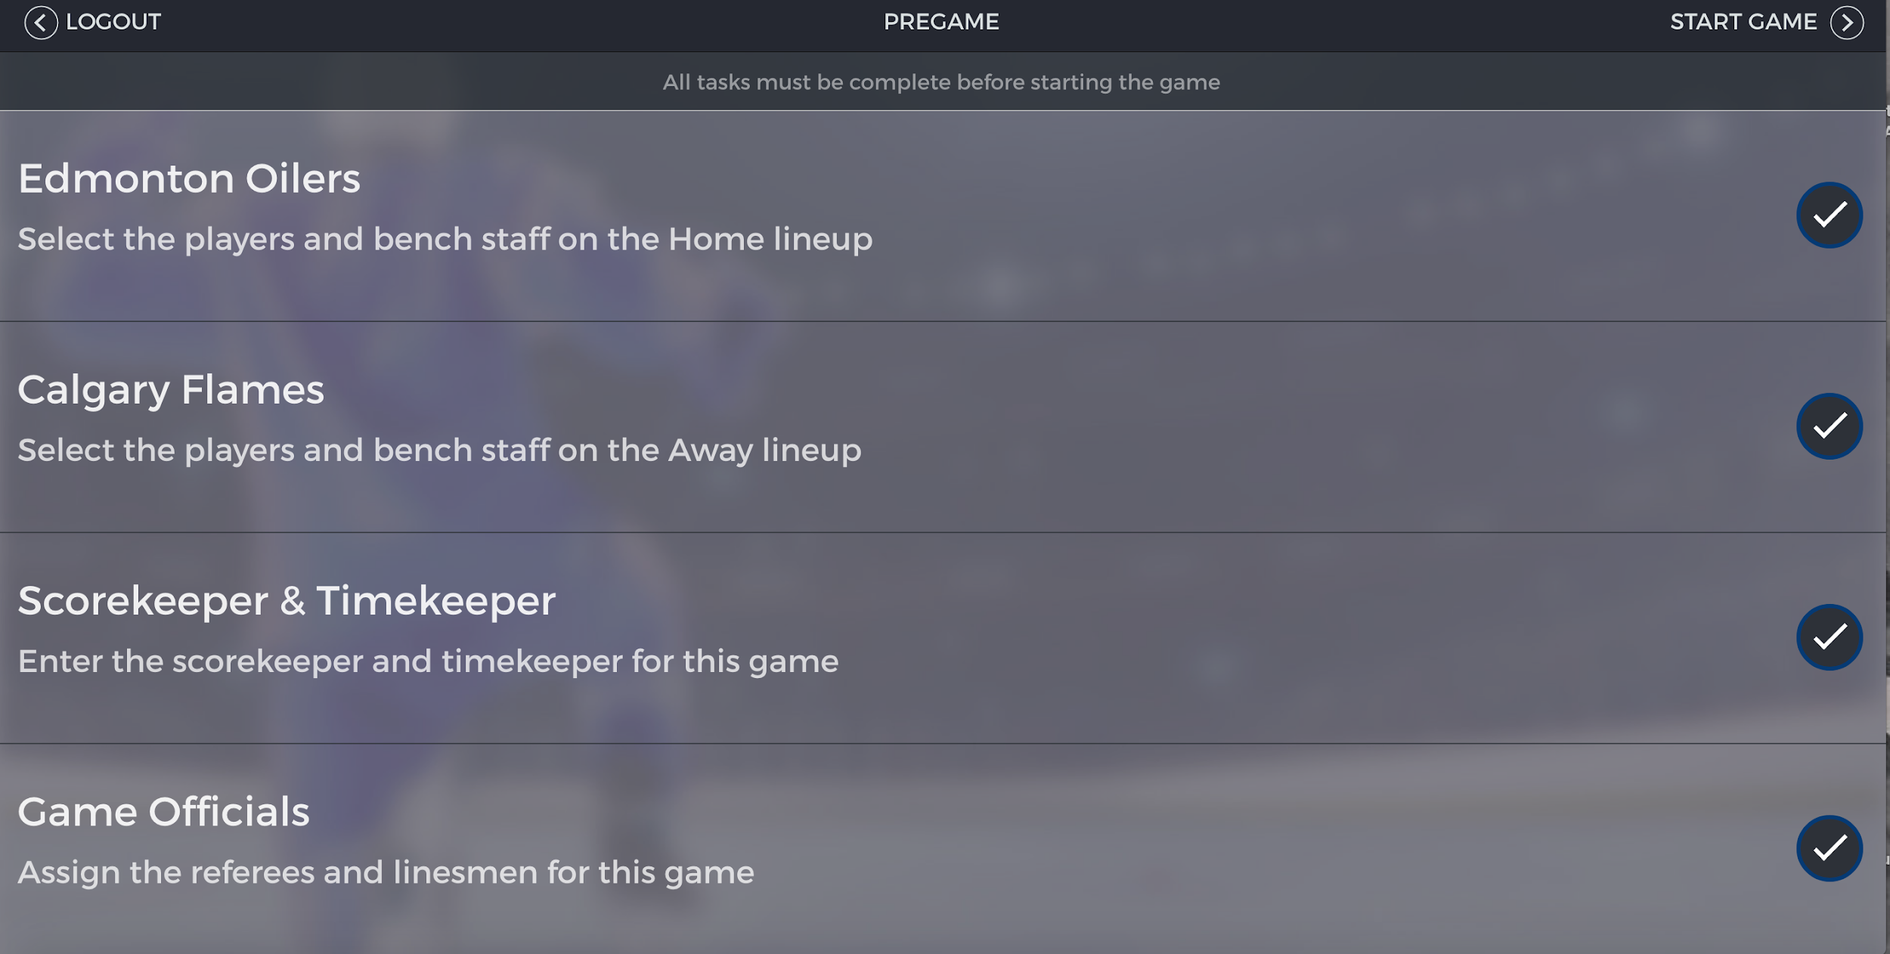
Once the game have started, it can be offline until the end. Note that whatever device you are using, it need to get back to cell or wifi in order to upload game events that are used to generate Electronic Scoresheet

Slide 7
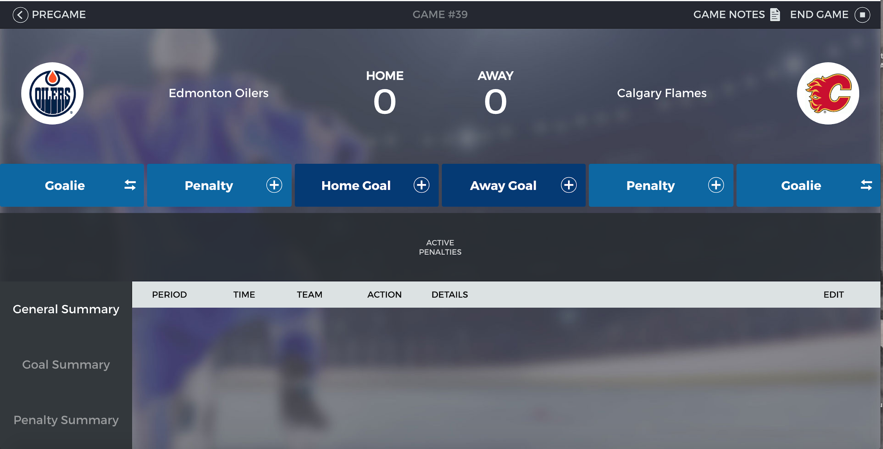
From that point on the scorekeeping can be done OFFLINE

Slide 8
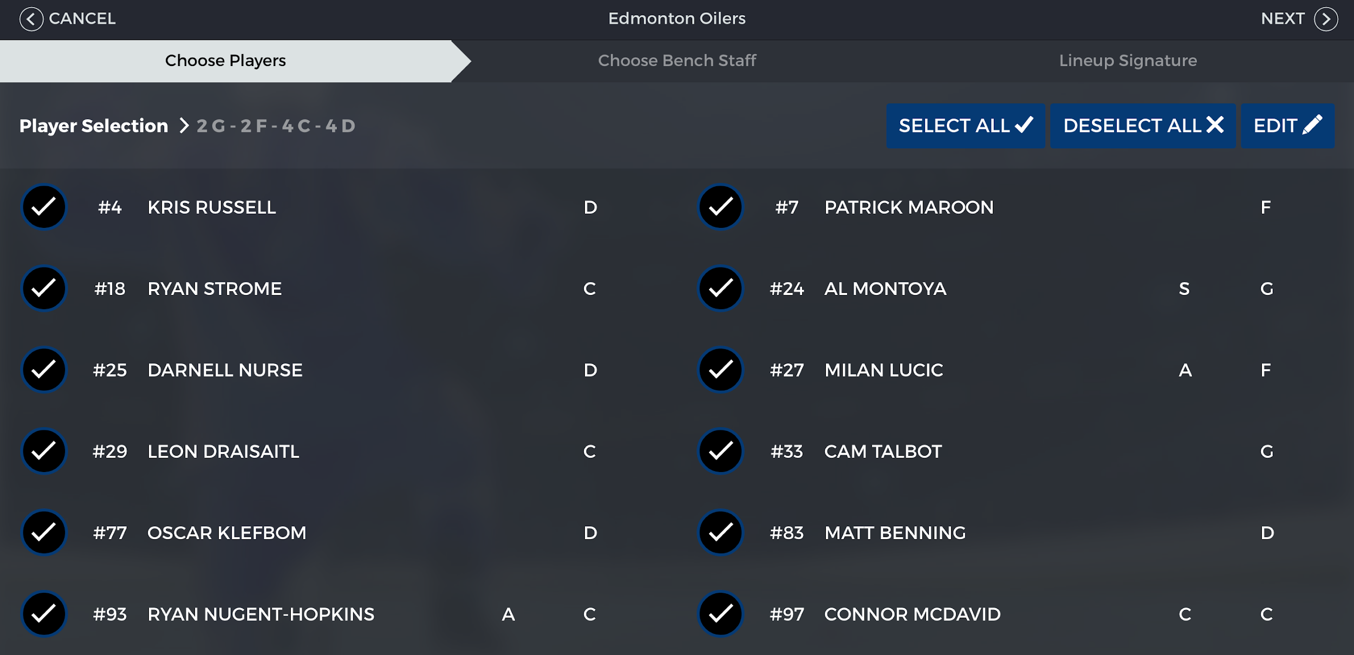
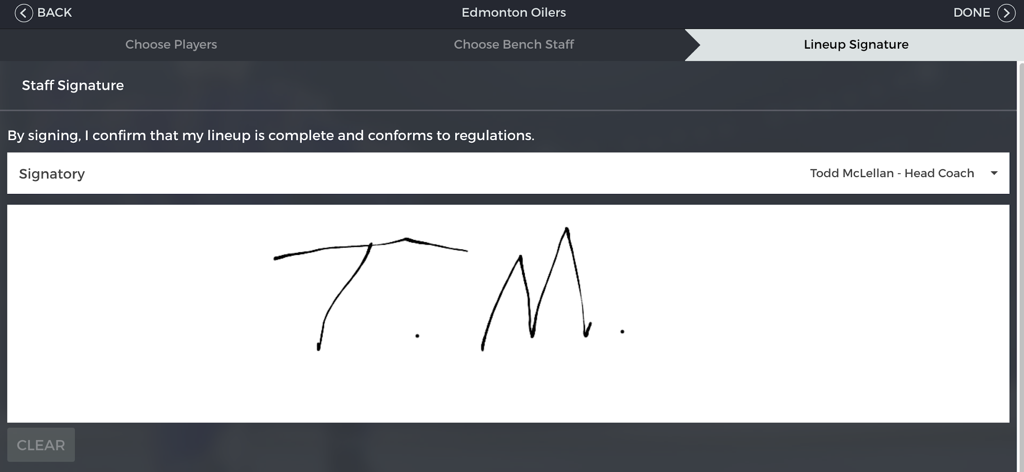
REFEREES
SELECT TEAM
Pre Game Process
  Select the team you want to validate roster
  Repeat same process for the other team
  Make sure Team Official have signed
End Game Process (Next Slide)
  Select the team you want to validate roster
  Repeat same process for the other team
  Make sure Team Official have signed
VALIDATE ROSTER
VALIDATE TEAM OFFICIAL SIGNATURE

Slide 9
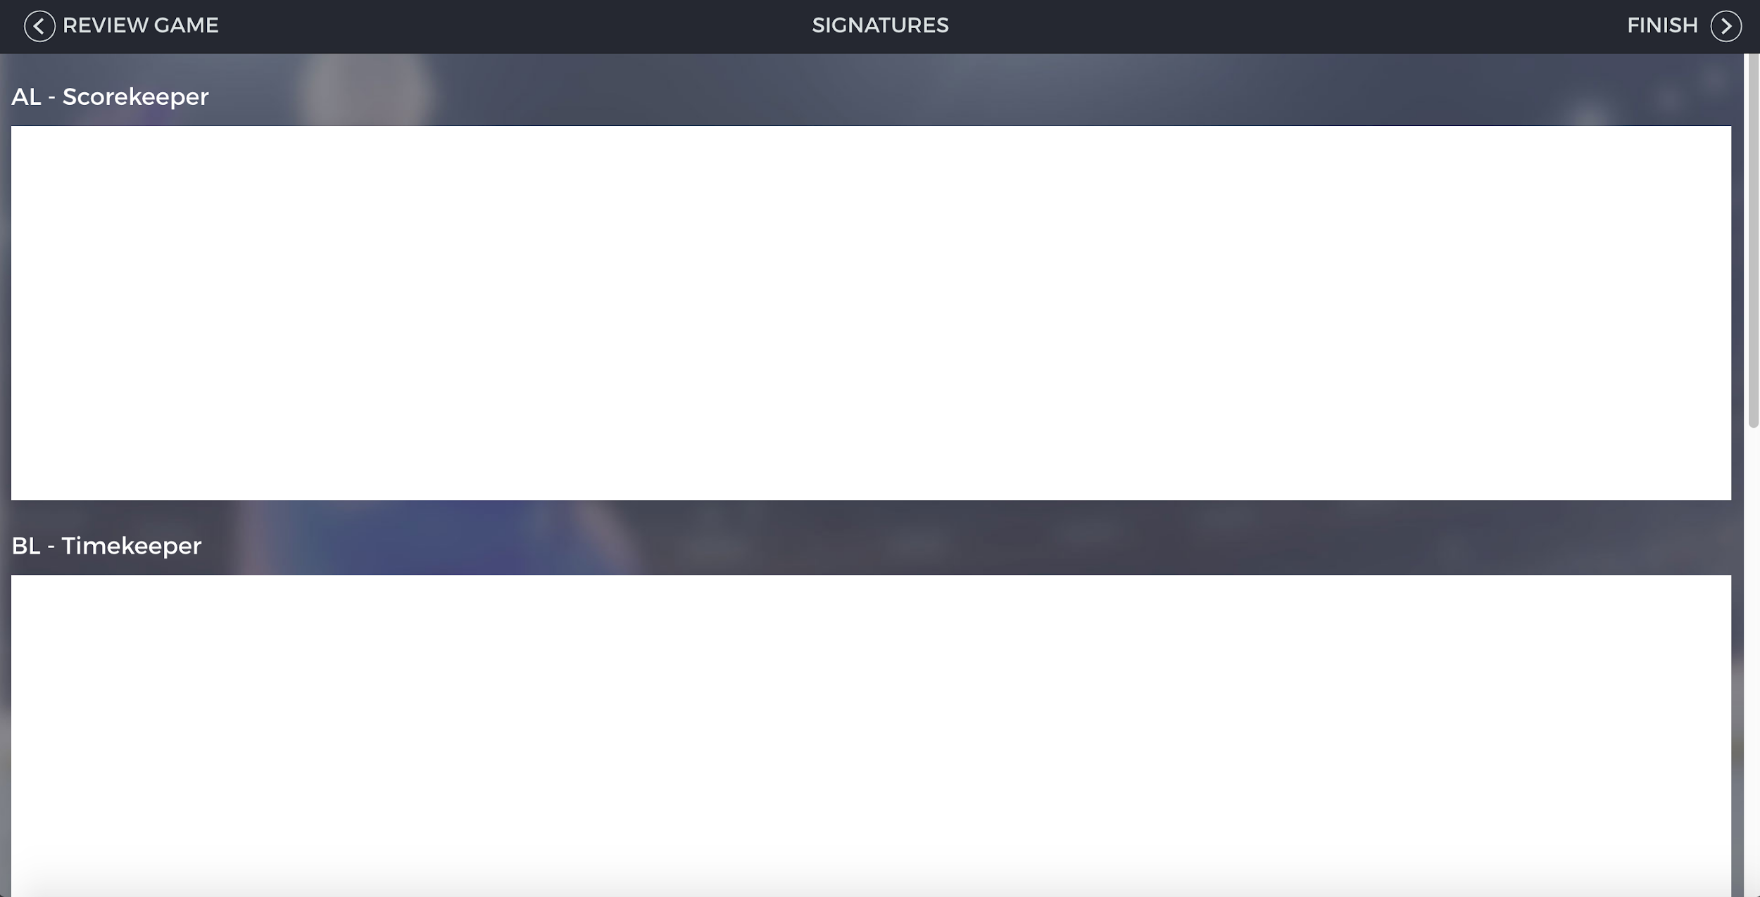
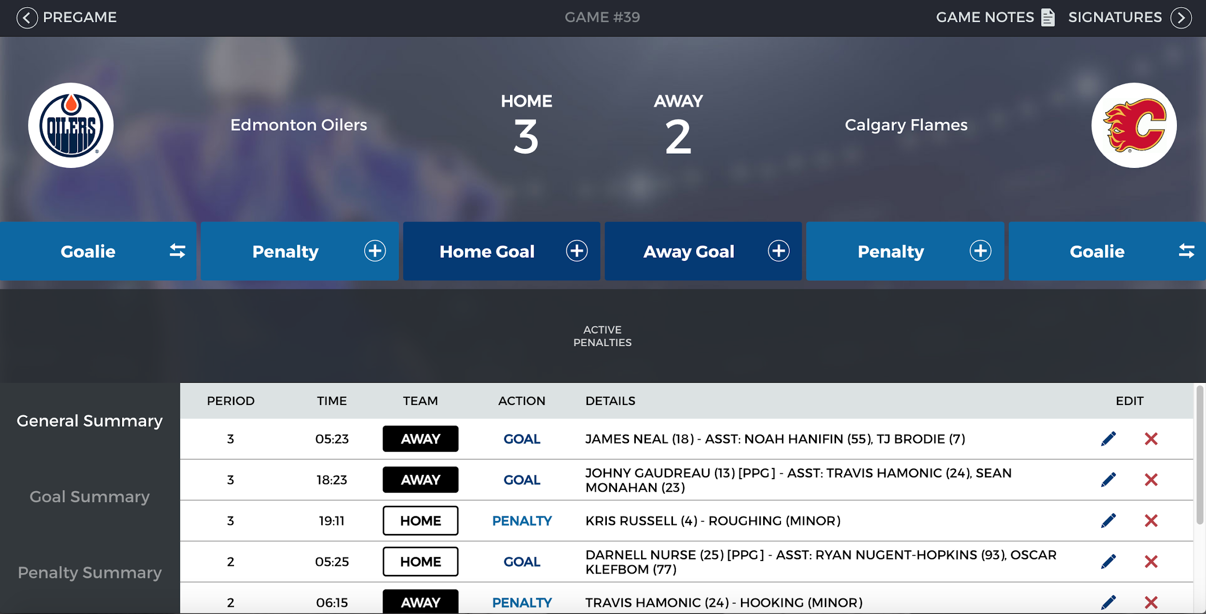
REFEREES
Pre Game Process
  Select the team you want to validate roster
  Repeat same process for the other team
  Make sure Team Official have signed
End Game Process
  Before scorekeeper and timekeeper sign, referee need to review game events in order to validate if everything is as expected
  When the referee is done she or he can go back to Signature page
  If there were major penalties and the referee needed to do a report, you can add her or his email before the end game process is completed
REVIEW GAME
VALIDATE TEAM OFFICIAL SIGNATURE
BACK TO SIGNATURE PAGE

Slide 10
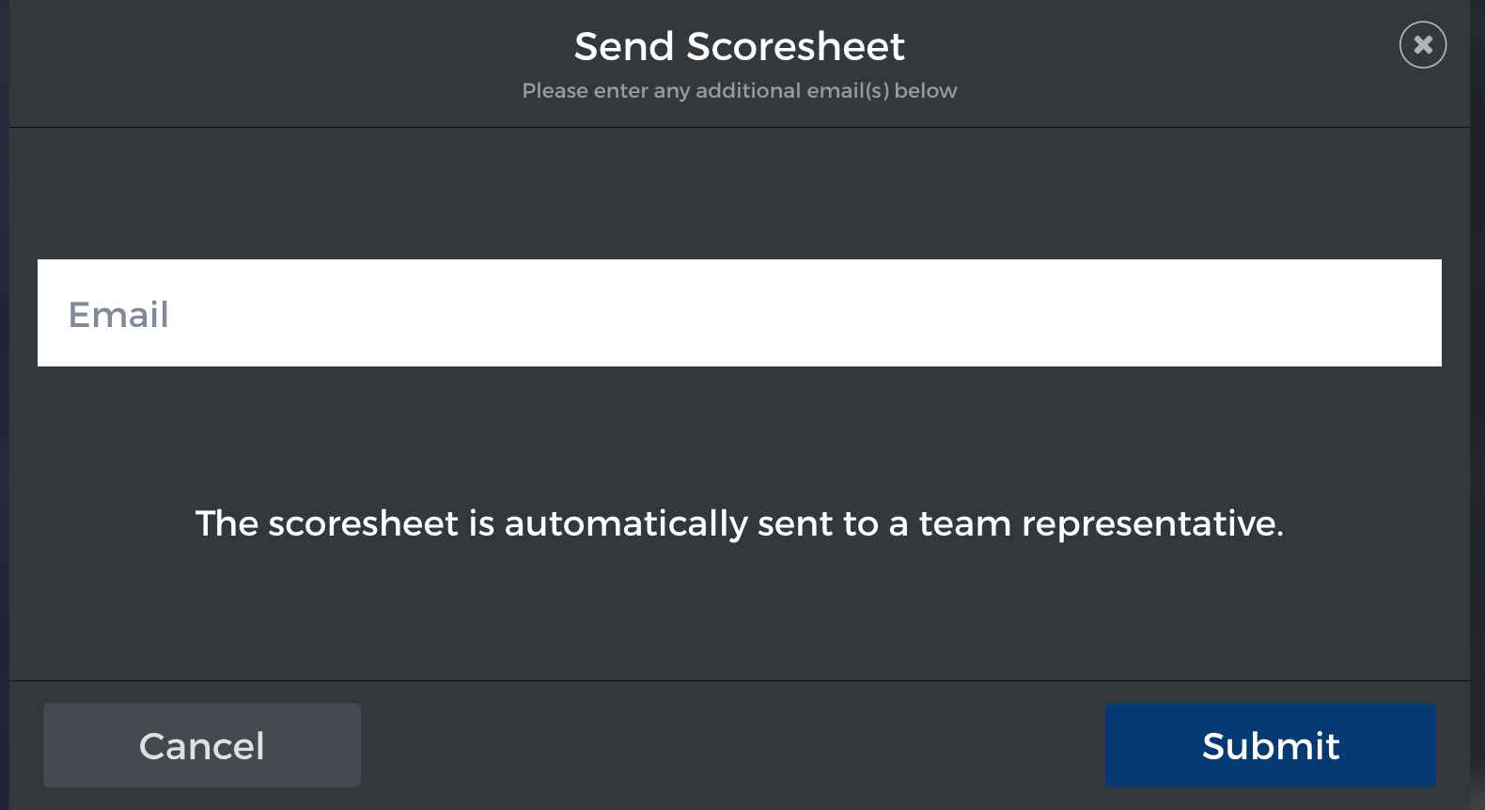
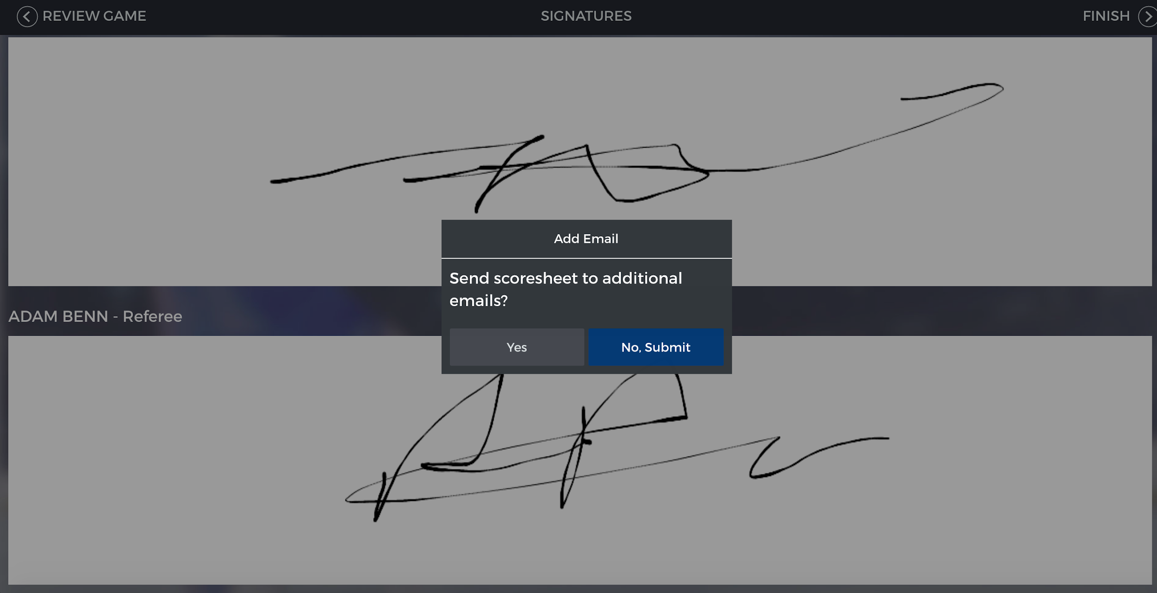
REFEREES
Key in your email address and hit SUBMIT

Slide 11
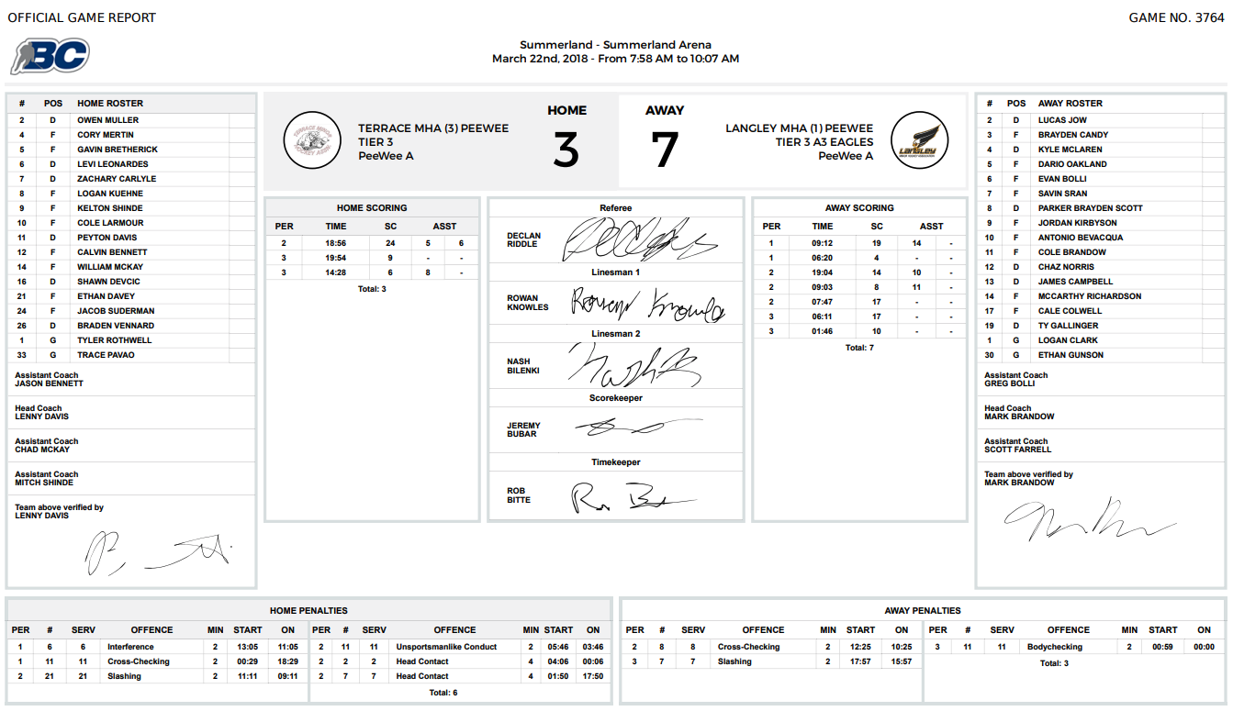
GAME REPORT
Every registered Team Officials wiil received by email a PDF version of the scoresheet
Registrars have access to all gamesheets under their responsibility
Only registrars can edit game reports
It is strongly suggested for scorekeeper to use a notepad during the games
(see sample from last year next slide)

Slide 12
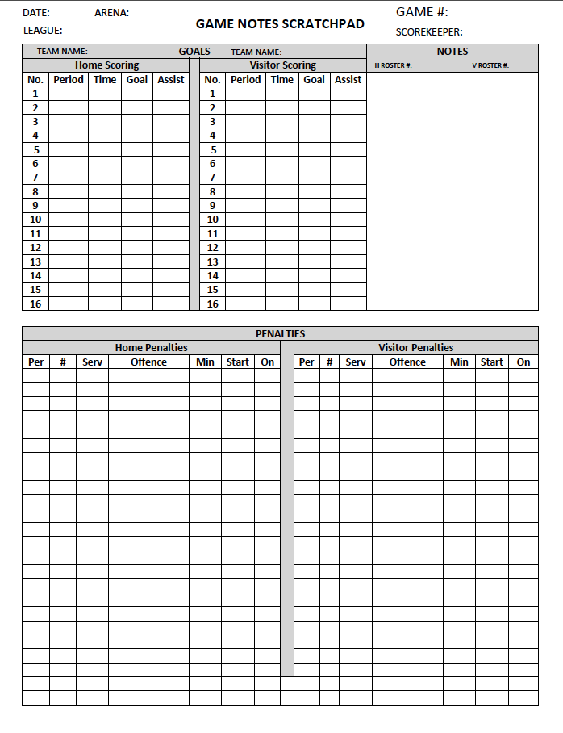
GAME NOTE SCRATCHPAD
Every registered Team Officials wiil received by email a PDF version of the scoresheet
Registrars have access to all gamesheets under their responsibility
Only registrars can edit game reports
It is strongly suggested for scorekeeper to use a Game Note Scratchpad during the games
(see sample from last year next slide)

